Slide 1

Complex
Procedural
Terrains
Zhimin Zhao
11/16/2015

Slide 2

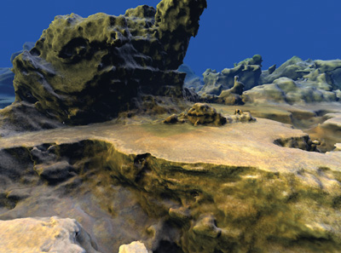
What is procedural terrain?
Creating terrain algorithmically as opposed to manually
What's gonna improve for my project?
Traditionally:
height field(CPU)
render(GPU)
Drawback:
uninteresting features(simple hf)
slow serial processing
GPUCUDA
2

Slide 3
Main Procedure
1.Marching Cubes and the Density Function
2.Terrain Generation
3.Texturing and Shading
4.LOD(Level of Detail)
3

Slide 4
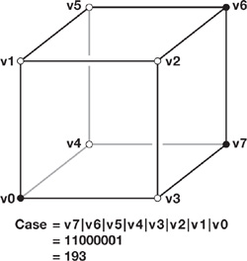
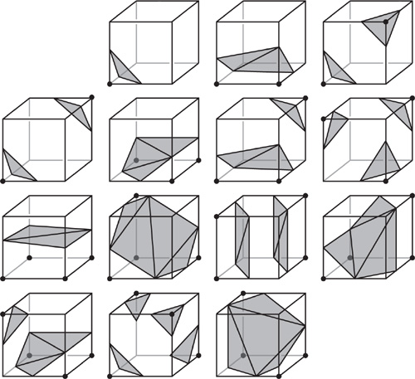
Marching Cubes and the Density Function
Density function d(x, y, z).
d>0, inside the solid terrain; bit 1
d<0, in empty space; bit 0
d=0, the surface of the terrain.
The 14 Fundamental Cases(0~2⁸-1) for Marching Cubes:
5
Notes:
We then logically concatenate these 8 bits to produce a byte. If the case is 0 or 255, then the cell is entirely inside or outside the terrain and no polygons will be generated. Or else, it is used to index into various lookup tables to determine how many polygons to output. The vertex should be placed where the density value is approximately zero and thus we could get a triangle list output.

Slide 5
Marching Cubes and the Density Function
Lookup Table:
1.how many polygons to create for the case number
2.how to build up to five triangles within the cell
5
Notes:
We then logically concatenate these 8 bits to produce a byte. If the case is 0 or 255, then the cell is entirely inside or outside the terrain and no polygons will be generated. Or else, it is used to index into various lookup tables to determine how many polygons to output. The vertex should be placed where the density value is approximately zero and thus we could get a triangle list output.

Slide 6
Terrain Generation
1. For each frame, we sort all the vertex buffers from front to back.
2. we use the GPU's pixel shader (PS) unit to evaluate the complex density function at every cell corner within the block and store the results in a large 3D texture.
3. Generating the Polygons Within a Block of Terrain
4. Generating the Density Values
5.Making an Interesting Density Function
6

Slide 7
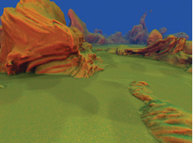
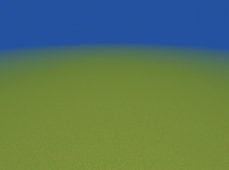
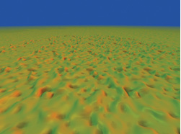
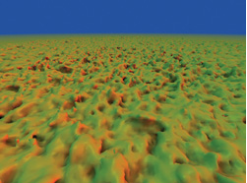
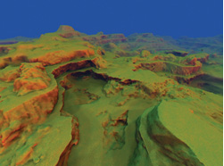
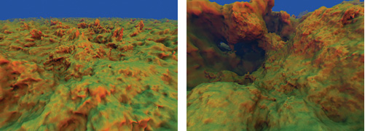
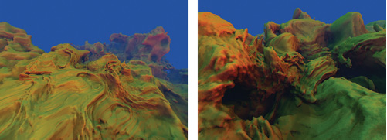
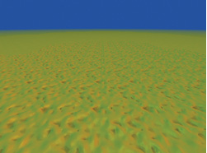
Making an Interesting Density Function
1.Initialize a flat surface
2.Warp the ground plane with a single octave of noise
3.Modify the frequency & amplitude of the noise by scaling ws & the result of the lookup
4.Add more octave noises
5.Add lower frequencies at higher amplitude(trilinear interpolation)
6.Warp the ws creates a surreal-looking terrain(hard floor -more landlike)
7.Make the adjustment by using either the pre-warp or the post-warp ws(melt & sag)
8.Customizing the Terrain
(1)Use a hand-painted 2d texture
(2)Add manually controlled influences
(3)Add miscellaneous effects
7

Slide 8
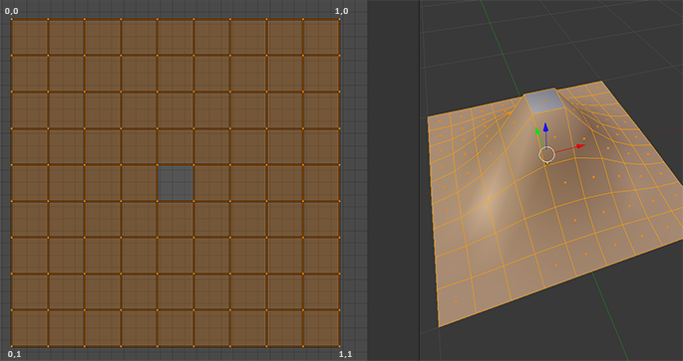
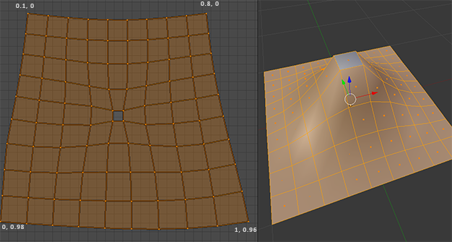
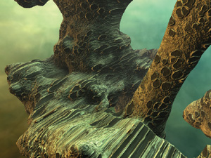
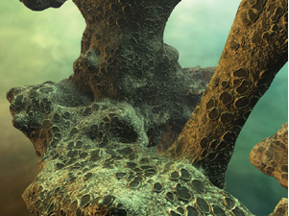
Texturing and Shading
triplanar texturing
Single Planar Projection Is
Plagued by Distortion
Three Planar Projections of the Same Texture, Blended Together Based on the Surface Normal Vector
8
Notes:
We use triplanar texturing, namely, three different planar projections, one along each of the three primary axes (x, y, and z). At any given point, we also use the projection that provides the least stretching at that point, with some projections blending based on the surface normal in the in-between areas.

Slide 9
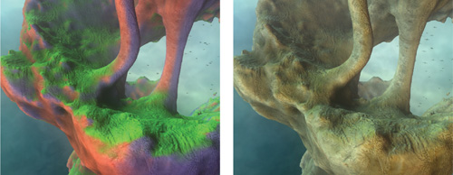
MileStone 1: 11/23
Setup a Blinn-Phong shader then generate terrain by integrating different noise function
MileStone 2: 11/30
Generate polygons within a cell using marching cube
MileStone 3: 12/07
Triplanar texturing & optimize block generating
狗带 Day: 12/11
LOD (Level of Detail)
Media Usuarios Únicos Diarios (000)
9

Slide 10

Acknowledgement
http://http.developer.nvidia.com/GPUGems3/gpugems3_ch01.html
Reference Material
NBody-Simulation Base Code
10

Slide 11

THANK U

